Slide 1

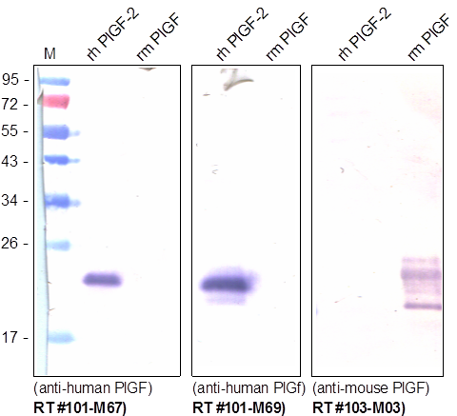
ReliaTech GmbH
Rabbit anti-human PlGF
(Cat# 101-M67 / 101-M69 / 103-M03)
Western Analysis with different monoclonal antibodies against human PlGF. Both human antibodies do not show any cross reactivity with mouse PlGF. The monoclonal rat anti-mouse PlGF shows no cross reactivity with the human PlGF-2.
http://www.reliatech.de / orders@reliatech.de

